Slide 1
How Head Start and Refugee Resettlement Agencies Can Work Together to Serve the Refugee Community
Notes:
This is a presentation to be used by Head Start staff to promote Head Start services and benefits to refugee resettlement agencies. The presentation also showcases a new toolkit with materials that resettlement agencies can use to promote Head Start to children and families with refugee status.

Slide 2
Introducing Head Start and Early Head Start
Head Start is an early childhood education model committed to 360-degree development of the whole child—providing a strong foundation to help set children up for a lifetime of learning and growth in school and in the wider world.
Head Start preschool programs serve the families of children ages 3 and 4.
Early Head Start programs serve pregnant women and the families of children from birth through age 2.
Services are delivered in child development centers (schools with classrooms), in the home, or in a family child care setting (such as an in-home daycare) in every state.
1,700 agencies across the United States tailor this federal program to the needs of families in their service areas.
Head Start programs work to employ parents of children with refugee status in a variety of skilled and unskilled positions.

Slide 3
Head Start is a fantastic fit for families and children with refugee status
Head Start is an ideal partner to support families with refugee status as they integrate into new communities in the United States.
Head Start’s work epitomizes the hope and promise of a better life in the United States that many people with refugee status risk their lives to obtain.
Head Start’s strengths-based approach focuses on one’s abilities rather than one’s shortcomings.
Head Start has long recognized that equity and inclusion are critical to effective community engagement.

Slide 4
Services for children and families
Family
well-being
Community partnerships
Health
Children receive:
Free health and development screenings
Oral and mental health support
Nutritious meals
Parents receive support for achieving goals related to:
Housing stability
Continued education
Employment
Financial security
Community partnerships help meet family needs related to:
Immigration and legal
Housing
Job searches and training
And more
Programs connect families with medical, dental, and mental health services and ensure that children receive the services they need.
Programs support and strengthen parent–child relationships and engage families in children’s learning and development.
Head Start programs establish community partnerships to collaborate on fulfilling families’ needs.
Notes:
Head Start programs support the well-being of the whole child, and that includes offering services to support the families of enrolled children. Head Start’s range of services helps ensure children’s success in school and the wider world.

Slide 5
Early learning in Head Start
Picture
Listening, understanding, and using language to communicate with others
Reading and writing
Reasoning, memory, problem-solving, and thinking skills that help young children understand and organize their world
Using their senses to gather and understand information and respond to the world
Developing their gross and fine motor skills, which refers to moving their bodies and grasping, holding, and manipulating small objects
Learning to keep themselves safe and healthy
Creating and sustaining meaningful relationships with adults and other children
Expressing, recognizing, and managing their own emotions and responding appropriately to others’ emotions
Notes:
Educators and adults in children’s lives teach young children with learning what they need to know to succeed in grade school and in life. They receive age-appropriate instruction in a number of activities, some of which are listed on this slide.

Slide 6
Children benefit from enrollment in Head Start
Children who attend Head Start receive:
Education that supports learning in both English and the language the child’s family speaks at home
Care in a safe space where they can learn and play while parents work
Free health care, including medical, mental health, dental, hearing, and vision
Free breakfast, lunch, and snacks
Compared with peers who don’t attend Head Start, children enrolled in Head Start programs are more likely to:
Graduate from high school and attend college
Have improved social, emotional, and behavioral development
Be better prepared to be parents themselves

Slide 7
Employment opportunities at Head Start
Head Start offers a wide range of employment opportunities.
Teachers
Cooks
Office assistants
Teachers’ assistants
Cleaning/ maintenance staff
Bus/van/truck drivers
Classroom aides
Accountants
Data entry technicians
Infant/toddler caregivers
Notes:
These are just some of the many different positions Head Start hires for.

Slide 8
Benefits of working at Head Start
Flexibility—Part-time, full-time, and volunteer jobs in and out of the classroom
Convenience—The ability to work in the same place their child learns
Compensation—Good pay and benefits
Some programs offer year-round compensation and others offer compensation only during the school year
Total benefits, such as health insurance, depend on the program location and whether you work full- or part-time
Comfort—Safe, family-oriented, inclusive, and diverse work environments
Community—Opportunity to meet other parents, professionals, and people in their community
Assistance—Help with meeting the needs of their family
Skills building—Build communications and other skills on the job, including learning English as a second language
Advancement—Professional development to
Improve their skills in serving children and families
Increase their earning potential
Meet degree or certification requirements
Notes:
Head Start programs support the well-being of the whole child, and that includes offering services to support the families of enrolled children. Head Start’s range of services helps ensure children’s success in school and the wider world.

Slide 9
Introducing a new toolkit to connect resettlement agencies and Head Start
To better explain our offerings, we have created a toolkit with new, customizable materials that you can use to promote Head Start at your resettlement agency:
Fact sheets
Posters and flyers
Social media ads
Text messages
Main Goals:
1
Provide clear and simple information about how to enroll children with refugee status in Head Start
2
Provide clear and simple information that allows adults with refugee status to apply for jobs at Head Start
3
Help resettlement agencies and Head Start programs better understand each other’s services and how to collaborate to serve children and families with refugee status

Slide 10
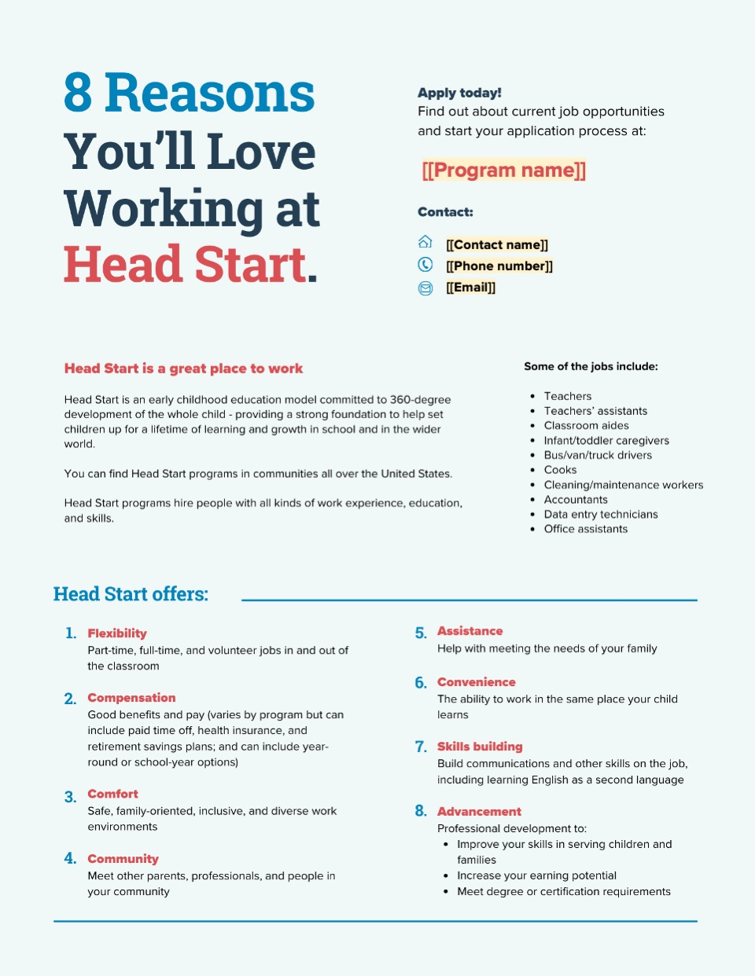
Poster example
Consider printing and hanging the posters in this toolkit to help advertise Head Start opportunities and benefits for children and families with refugee status.

Slide 11
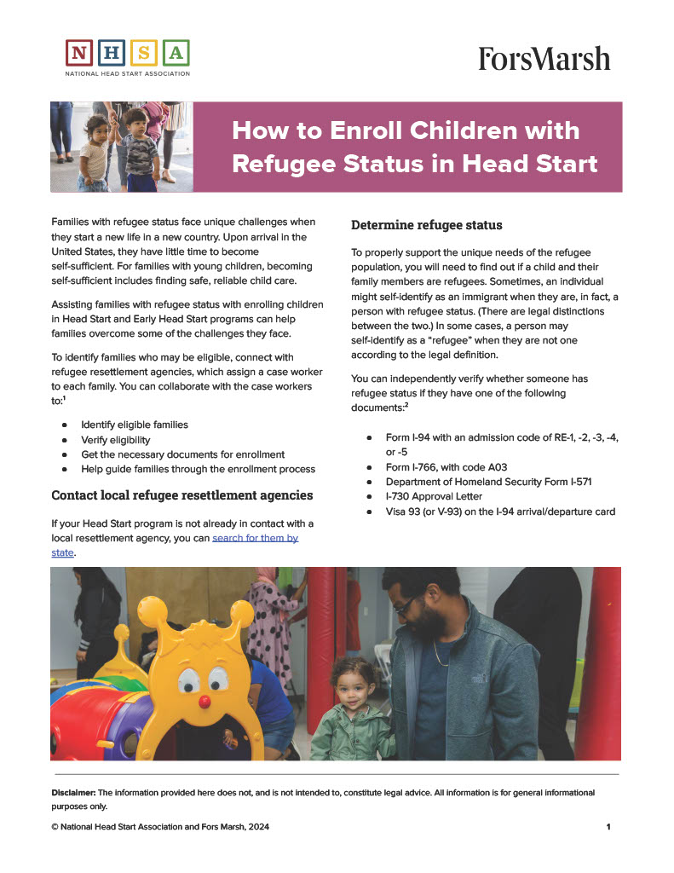
Fact sheet example
You can reference the fact sheets in this toolkit when introducing Head Start to families with refugee status. Fact sheets contain simple, clear information on Head Start benefits; how to enroll children; and how to apply for jobs.

Slide 12
Key takeaways
Head Start is an early childhood education model committed to 360-degree development of the whole child—providing a strong foundation to help set children up for a lifetime of learning and growth in school and in the wider world.
Head Start is an ideal partner to support families with refugee status as they integrate into new communities in the United States.
Children enrolled in Head Start receive a range of services including but not limited to free health and development screenings, oral and mental health support, guidance in early learning and development, and nutritious meals and snacks.
Parents and guardians of enrolled children are eligible to apply for employment with Head Start, which offers a wide range of jobs. This gives parents and guardians the opportunity to work at the same place their child learns.
Head Start has created a new toolkit with customizable materials that resettlement agencies can use to connect children and families with refugee status to Head Start. Materials include fact sheets, posters/flyers, social media advertisements, and text messages.

Slide 13
Contact information
For more information about Head Start, or if you’d like assistance with enrollment or job applications, please reach out to me at the email address or phone number below.
PRESENTER NAME
PHONE NUMBER (XXX) XXX-XXXX
EMAIL ADDRESS
HEAD START PROGRAM NAME
PROGRAM STREET ADDRESS, STATE, CITY, ZIP CODE

